Slide 1
Secure Your Relationships
Intimate relationships

Slide 2
Introduction to consent.
Misconceptions about consent.
Understanding capacity

Slide 3
Secure Your Relationships:
Intimate relationships
Introduction to consent

Slide 4

Introduction to Consent
Consent is about saying "yes" or "no" to things that involve you.
It's important in all relationships, including friendships.
Consent must be given freely and can be changed at any time.
It's a way to respect each other's choices and boundaries.
Can you give an example of how you might ask for consent in everyday situations?
What do you think consent means in friendships or any relationship?
Notes:
Please give time for the students to produce answers for themselves before showing answers.

Slide 5
Consent is Necessary
Asking for consent shows you respect the other person.
It's necessary for activities that involve touching, sharing, or personal space.
Without consent, the other person might feel uncomfortable or upset.
Consent helps build trust in any relationship.
How would you feel if someone did something that involved you without asking first?
Why do you think it's important to ask for consent before doing something that affects someone else?
Notes:
Please give time for the students to produce answers for themselves before showing answers.

Slide 6
Giving and Withdrawing Consent
Yes, consent can be changed or taken back at any time.
It's okay to say "no" even after saying "yes" if you feel uncomfortable.
Everyone should respect the decision without getting upset.
Checking in regularly is part of maintaining consent.
What might you say if you need to change your consent?
Can someone change their mind after they've said "yes" to something?
Notes:
Please give time for the students to produce answers for themselves before showing answers.

Slide 7
Signs of Consent
Consent can be given by saying "yes" or nodding, but should always be clear.
Not saying "no" doesn't mean yes. Silence or being unsure isn't consent.
Body language and expressions can also show how someone feels.
Always ask if you're not sure and respect the answer.
Why is it important to make sure consent is clear and not assumed?
What are some ways someone can show they agree (give consent) or disagree (not give consent)?
Notes:
Please give time for the students to produce answers for themselves before showing answers.

Slide 8
Yes, No, Maybe So
Actions | Yes, No, Maybe
High fiving
Sharing a secret
Posting a photo together
Tagging someone without permission
Copying someone’s assignment
In pairs, discuss:
Discuss your choices.
Why might different actions be perceived differently?
What could affect someone’s decisions over consent?

Slide 9
Introduction to consent.
Misconceptions about consent.
Understanding capacity

Slide 10
Secure Your Relationships:
Building relationships
Misconceptions about consent.

Slide 11
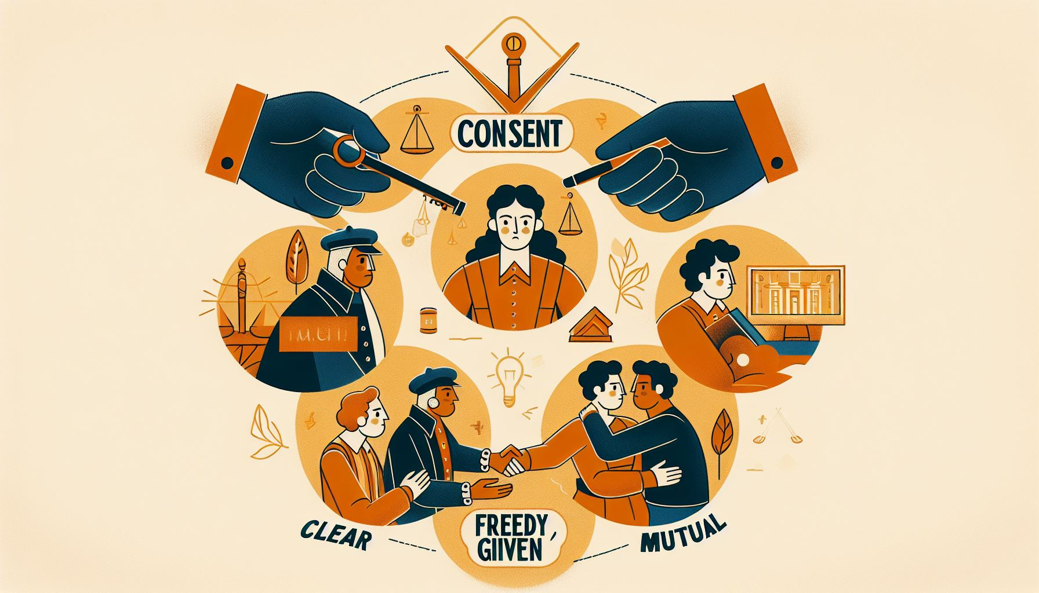
What is Consent?
Consent means agreeing to something with understanding and without pressure.
It’s specific to the situation and must be given every time.
Silence or not saying "no" does not mean yes.
Everyone has the right to change their mind at any time.
What words or phrases come to mind when you hear "consent"?
Why do you think it's important to explicitly say "yes" or "no"?
Notes:
Please give time for the students to produce answers for themselves before showing answers.

Slide 12
Consent is Not Assumed
Consent cannot be assumed from someone’s clothing, body language, or past actions.
It must be clearly and freely given.
Assuming consent can lead to misunderstandings or hurt.
Always communicate and ask rather than assume.
Can you assume someone has given consent based on their actions or clothing?
How might assumptions about consent affect someone’s feelings or safety?
Notes:
Please give time for the students to produce answers for themselves before showing answers.

Slide 13
Everyone’s Responsibility
Everyone involved in a situation must ensure consent is clear.
Asking for and giving consent is a mutual responsibility.
Checking in regularly shows care and respect.
Consent is an ongoing conversation, not a one-time question.
Why is it important to keep checking in, even if consent was given before?
Who is responsible for making sure consent is given and understood?
Notes:
Please give time for the students to produce answers for themselves before showing answers.

Slide 14
Misconceptions About Consent
Myth: If someone agrees to go on a date, they have consented to everything.
Myth: Consent once given cannot be taken back.
Myth: It’s only important in romantic situations.
Truth: Consent is needed in many situations, can always be changed, and must be specific.
How can understanding these truths help us respect others better?
What are some myths you’ve heard about consent?
Notes:
Please give time for the students to produce answers for themselves before showing answers.

Slide 15
‘In their Shoes’
Discuss how the person in the scenario might feel and what would be the best way to handle the situation respecting consent.
Context: Ayesha takes a selfie with their friend Faisal during lunch break and posts it on social media without asking Faisal’s permission. Faisal is uncomfortable with their image being shared online but doesn’t know how to bring it up to Ayesha.
Discussion Points:
How might Faisal feel about the photo being posted without their consent?
What could Ayesha have done differently before posting the photo?
Discuss the importance of consent in digital spaces and friendships.

Slide 16
Introduction to consent.
Misconceptions about consent.
Understanding capacity

Slide 17
Secure Your Relationships:
Building relationships
Understanding capacity

Slide 18

What is Capacity?
Capacity means being able to understand and decide about something.
It involves knowing what you're agreeing to and the consequences.
Everyone must have the capacity to give consent for it to be valid.
Being under the influence or feeling pressured can affect someone's capacity.
What do you think "having the capacity to consent" means?
Why is it important to make sure someone has the capacity to consent?
Notes:
Please give time for the students to produce answers for themselves before showing answers.

Slide 19
Consent and Influence
Consent should be given freely, without pressure, manipulation, or influence.
Being under the influence of substances can impair someone's capacity to consent.
Fear or pressure from others can also affect a person's ability to consent.
True consent requires all parties to fully understand and agree voluntarily.
Can someone consent if they are under pressure or influenced by others?
How can pressure or influence from others affect someone's decision to consent?
Notes:
Please give time for the students to produce answers for themselves before showing answers.

Slide 20
Recognising Capacity
Check if they understand what they're agreeing to and can explain it back.
Ensure they know the possible outcomes of their decision.
Make sure their decision is made without undue influence or pressure.
It's important to respect someone's right to say no at any time.
What might you do if you're unsure about someone's capacity to consent?
How can you tell if someone has the capacity to make a decision?
Notes:
Please give time for the students to produce answers for themselves before showing answers.

Slide 21
Respecting Boundaries
Respecting capacity is key to healthy and respectful relationships.
It ensures that all parties feel safe, valued, and heard.
Ignoring someone's capacity can lead to harm and distrust.
We must always communicate openly and respect each other's boundaries and decisions.
Why is respecting someone's capacity to consent important in all relationships?
How does respecting each other's capacity and boundaries build trust?
Notes:
Please give time for the students to produce answers for themselves before showing answers.

Slide 22
Consent and Capacity Quiz
What does consent mean?
A) Agreeing to something because you feel pressured
B) Agreeing to something with understanding and without pressure
C) Ignoring someone's decision
D) Agreeing only once for everything
Answer: B
Notes:
Discuss the answers when student disagree with the answers

Slide 23
Consent and Capacity Quiz
Can someone change their mind after they've given consent?
A) No, once consent is given, it cannot be changed
B) Yes, but only in certain situations
C) Yes, consent can be changed or withdrawn at any time
D) No, consent is permanent
Answer: C
Notes:
Discuss the answers when student disagree with the answers

Slide 24
Consent and Capacity Quiz
Which of the following affects a person's capacity to consent?
A) Their favourite colour
B) Being under the influence of substances
C) Their age
D) B and C
Answer: D
Notes:
Discuss the answers when student disagree with the answers

Slide 25
Consent and Capacity Quiz
Consent must be...
A) Assumed based on past actions
B) Given for each new situation
C) Only verbal
D) Only necessary once
Answer: B
Notes:
Discuss the answers when student disagree with the answers

Slide 26
Consent and Capacity Quiz
Which is a sign that someone may not have the capacity to consent?
A) They ask questions
B) They give a clear 'yes'
C) They seem unsure or confused
D) They are over 16 years old
Answer: C
Notes:
Discuss the answers when student disagree with the answers

