Slide 1
Secure Your Relationships
Identity and relationships

Slide 2
Qualities of positive, healthy relationships
Demonstrating positive behaviours in relationships.
Healthy vs. unhealthy relationships

Slide 3
Secure Your Relationships:
Building relationships
Qualities of positive, healthy relationships

Slide 4
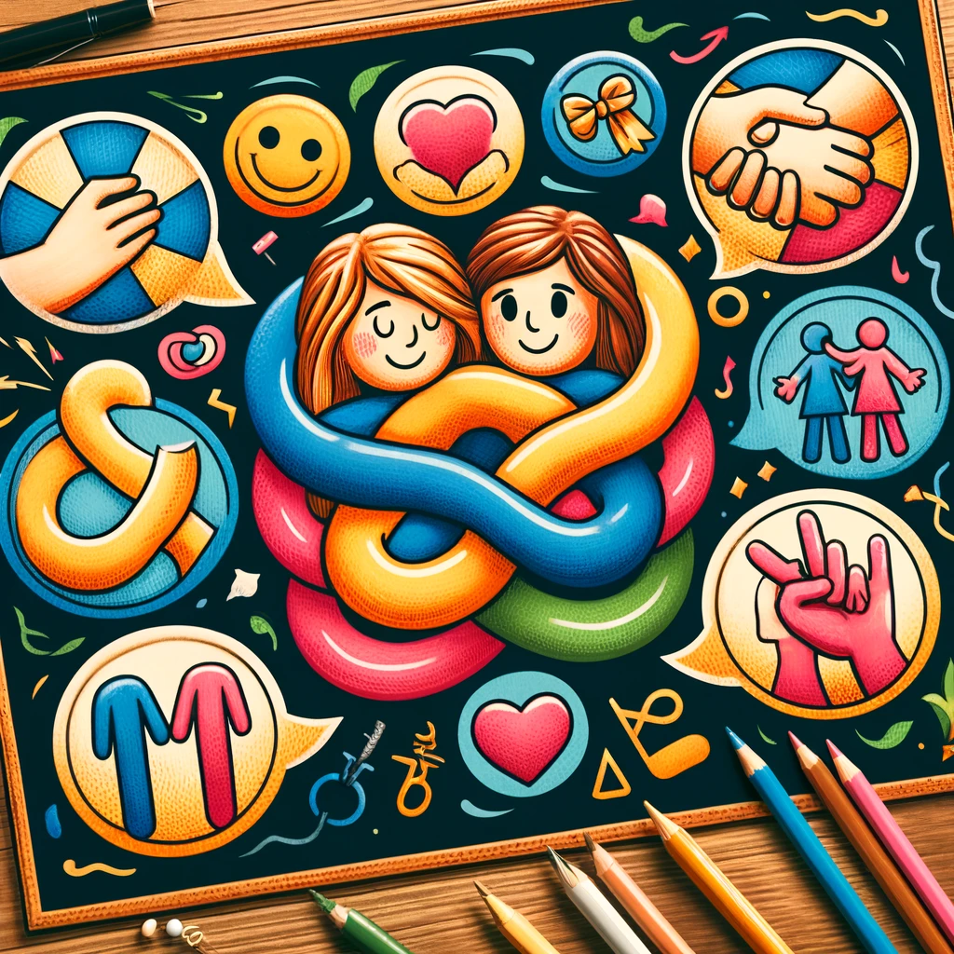
What is a Relationship?
A relationship is how two or more people are connected.
It can be with family, friends, or teachers.
Relationships should make us feel happy and supported.
Trust and respect are important in every relationship.
Can you name different types of relationships?
What do you think a relationship is?
Notes:
Please give time for the students to produce answers for themselves before showing answers.

Slide 5
Qualities of a Healthy Relationship
Good relationships are built on trust, respect, and understanding.
Listening to each other is very important.
Friends should support each other, especially when one is feeling down.
It's okay to have different opinions and still be friends.
Why is listening important in a relationship?
What makes a good friend?
Notes:
Please give time for the students to produce answers for themselves before showing answers.

Slide 6
How Do We Show Respect?
Saying "please" and "thank you."
Listening when others are speaking.
Being honest and kind.
Treating others how you want to be treated.
How do you show respect to others?
What are some ways you can show respect in school?
Notes:
Please give time for the students to produce answers for themselves before showing answers.

Slide 7
Communication in Relationships
Talking about how we feel is a big part of any relationship.
It's okay to say if something upsets you, but always be kind.
Asking for help is a sign of strength, not weakness.
Sharing and playing fairly is important.
Why is it important to talk about our feelings?
How do you talk to your friends and family?
Notes:
Please give time for the students to produce answers for themselves before showing answers.

Slide 8
Respect Bingo
Write down ten words that you think are respectful words to use in conversation.
Take the list of words with you.
Tomorrow feed back to the class how many times you heard someone (student, teacher, AC, ACC) use each word.

Slide 9
Qualities of positive, healthy relationships
Demonstrating positive behaviours in relationships.
Healthy vs. unhealthy relationships

Slide 10
Secure Your Relationships:
Building relationships
Demonstrating positive behaviours in relationships.

Slide 11
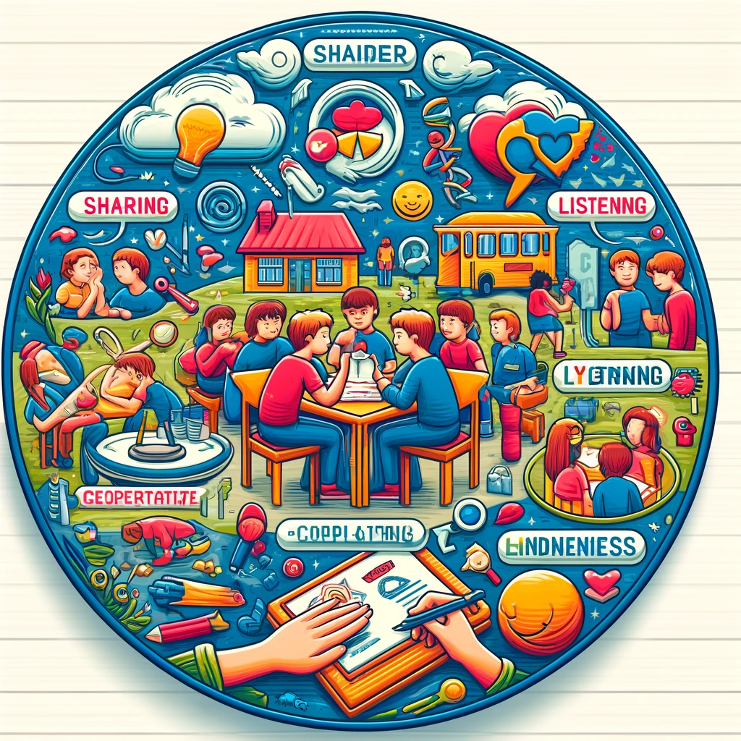
Listening to Each Other
Listening shows we care about others' feelings and ideas.
It helps us understand each other better.
Good listeners use their ears to listen, eyes for eye contact, and their heart to feel.
Listening is a way of showing respect.
How do you feel when someone really listens to you?
Why is it important to listen to our friends and family?
Notes:
Please give time for the students to produce answers for themselves before showing answers.

Slide 12
Sharing and Cooperation
Sharing is not just about things, but also about sharing time and help.
Cooperation means working together to make something good happen.
When we share and cooperate, everyone feels included.
Being generous makes our relationships stronger.
Why is it good to work together with others?
Can you think of a time when sharing something made you happy?
Notes:
Please give time for the students to produce answers for themselves before showing answers.

Slide 13
Showing Kindness
Kindness can be a smile, a helpful hand, or a kind word.
Small acts of kindness make a big difference.
Kindness is contagious; when we are kind, it inspires others to be kind too.
Being kind makes us and others feel good.
How does it feel to receive kindness?
What are some ways we can show kindness every day?
Notes:
Please give time for the students to produce answers for themselves before showing answers.

Slide 14
Respect in Action
Respect means treating others as you want to be treated.
It involves listening, understanding, and valuing differences.
Respectful behaviour creates a positive and safe environment for everyone.
We show respect by being polite, honest, and caring.
How can we show respect in our classroom?
What does respect look like to you?
Notes:
Please give time for the students to produce answers for themselves before showing answers.

Slide 15
Listening Pairs
Pair up with someone in your tutor group.
Discussion: Your favourite TV show.
One of the pair has 2 minutes to talk about your favourite TV show without disruption.
The listener will then summarise what they heard to practice active listening.
If you have time repeat the process, swapping roles.

Slide 16
Qualities of positive, healthy relationships
Demonstrating positive behaviours in relationships.
Healthy vs. unhealthy relationships

Slide 17
Secure Your Relationships:
Building relationships
Healthy vs. unhealthy relationships

Slide 18
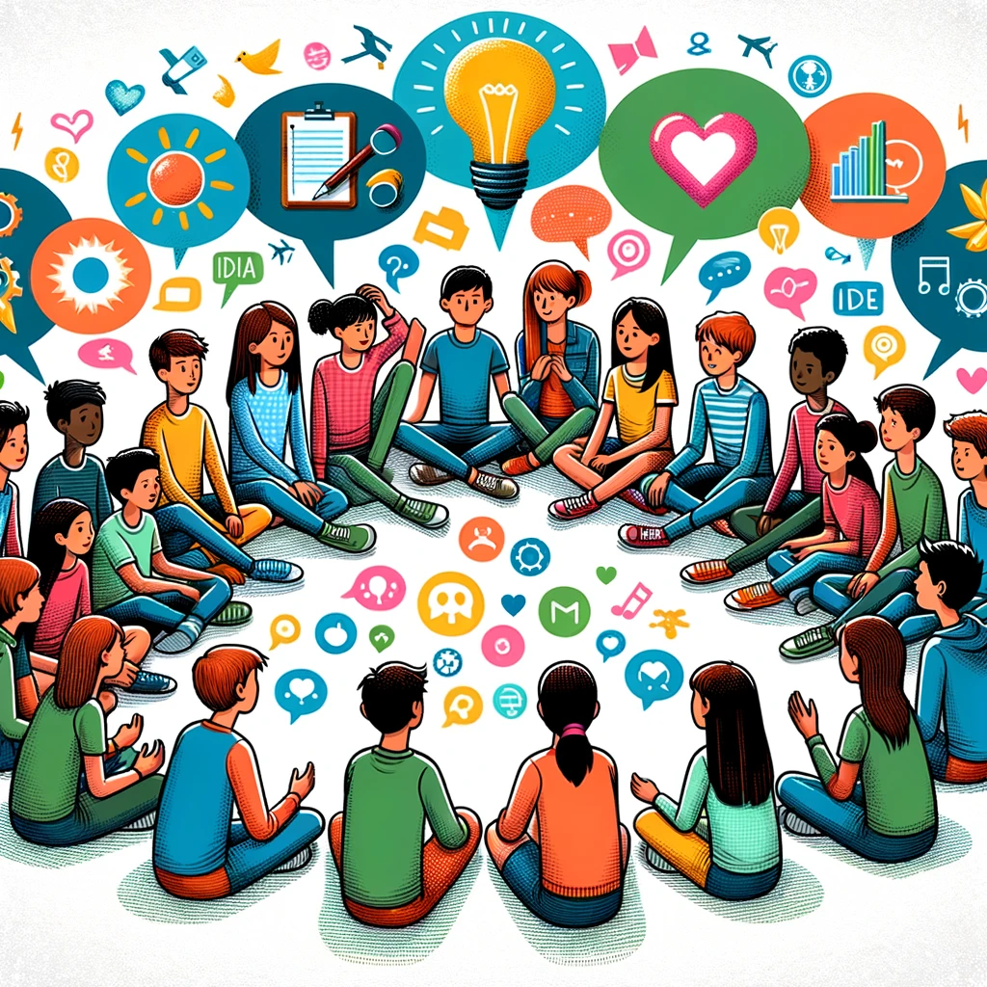
What Are Group Discussions?
A group discussion is when we talk about ideas or topics together.
Everyone gets a turn to speak.
We listen carefully when it's not our turn.
It's a chance to learn from each other.
What do you think we do in a group discussion?
Why is it important that everyone gets a turn to speak?
Notes:
Please give time for the students to produce answers for themselves before showing answers.

Slide 19
Listening in Discussions
Look at the person who is speaking.
Keep quiet and listen until they have finished.
Nod your head or say "I understand" to show you're listening.
Ask questions if you want to know more.
What can you do to be a better listener in our next discussion?
How do you show you are listening to someone?
Notes:
Please give time for the students to produce answers for themselves before showing answers.

Slide 20
Sharing Ideas Respectfully
Say "I think" or "I feel" to share your own ideas.
Listen to others' ideas, even if they are different from yours.
Say "please" and "thank you" when you talk.
Remember, every idea is important.
Why is it important to respect others' ideas?
How can you share your ideas without hurting anyone's feelings?
Notes:
Please give time for the students to produce answers for themselves before showing answers.

Slide 21
Making Group Decisions
Talk about different ideas and listen to everyone.
Think about what is best for the group, not just for you.
Sometimes we vote to make a decision.
We agree to support the decision, even if it wasn't our first choice.
How do we decide something as a group?
Can you think of a time when making a group decision was helpful?
Notes:
Please give time for the students to produce answers for themselves before showing answers.

Slide 22
Collaborative Storytelling
You will be telling a story about what you purchased when you went to the shops.
The first person starts saying ‘I went to the shops and brought an…’ and then an item starting with the letter ‘a' e.g. 'I went to the shops and brought an apple'
The next person repeats what has been said so far and adds an item to the list starting with the next letter in the alphabet e.g. 'I went to the shops and brought an apple; I went to the shops and brought a banana'.

