Slide 1
Secure Your Relationships
Building relationships

Slide 2
Self-Worth
Identifying personal strengths
Setting goals

Slide 3
Secure Your Relationships:
Building relationships
Self-Worth

Slide 4
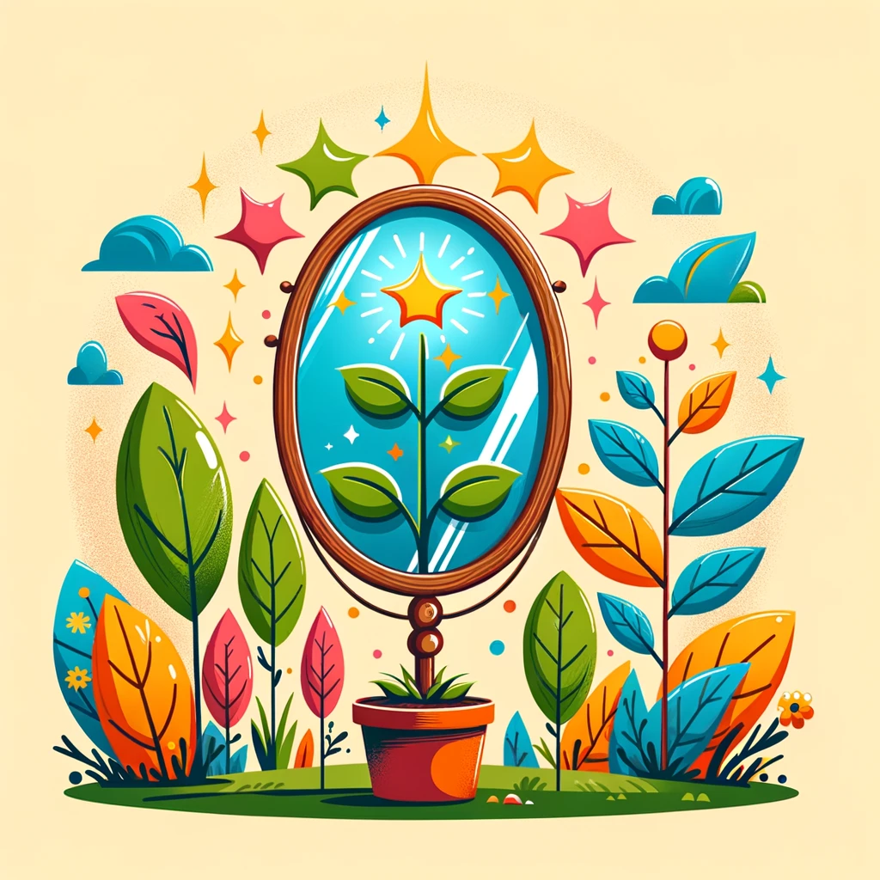
Understanding Self-Worth
Self-worth means how much you value yourself.
It’s like a voice inside that tells you, “You are important and capable.”
Having high self-worth means you believe you are a good person.
It helps you try new things and make friends.
What do you think self-worth means?
Why is it important to believe you are a good and capable person?
Notes:
Please give time for the students to produce answers for themselves before showing answers.

Slide 5
What Affects Our Self-Worth?
Things you do well can make you feel proud.
Kind words from others can boost how you see yourself.
Achieving goals, even small ones, makes your self-worth grow.
Overcoming challenges shows you can do hard things.
How do kind words from others make you feel about yourself?
Can you think of something that makes you feel good about yourself?
Notes:
Please give time for the students to produce answers for themselves before showing answers.

Slide 6
Why Self-Worth is Like a Seed
Self-worth starts small, like a seed.
When we take care of it, it grows into something strong, like a tree.
Learning new things and being kind to yourself helps it grow.
Everyone’s self-worth can grow, no matter where it starts.
How can you take care of your self-worth seed?
What happens to a seed when you water it?
Notes:
Please give time for the students to produce answers for themselves before showing answers.

Slide 7
How to Grow Your Self-Worth
Say nice things to yourself, like “I did my best today.”
Try new things. It’s okay if it doesn’t work out the first time.
Be a good friend to others and yourself.
Remember, everyone makes mistakes. It’s how we learn.
What is one way you can be kind to yourself?
What’s one new thing you want to try to help your self-worth grow?
Notes:
Please give time for the students to produce answers for themselves before showing answers.

Slide 8
Self-Worth Affirmation
Think of five positive affirmations about yourself.
Examples:
‘I am kind’
‘I am a good friend’
‘I can do hard things’
Make sure you are honest with yourself

Slide 9
Self-Worth
Identifying personal strengths
Setting goals

Slide 10
Secure Your Relationships:
Building relationships
Identifying personal strengths

Slide 11
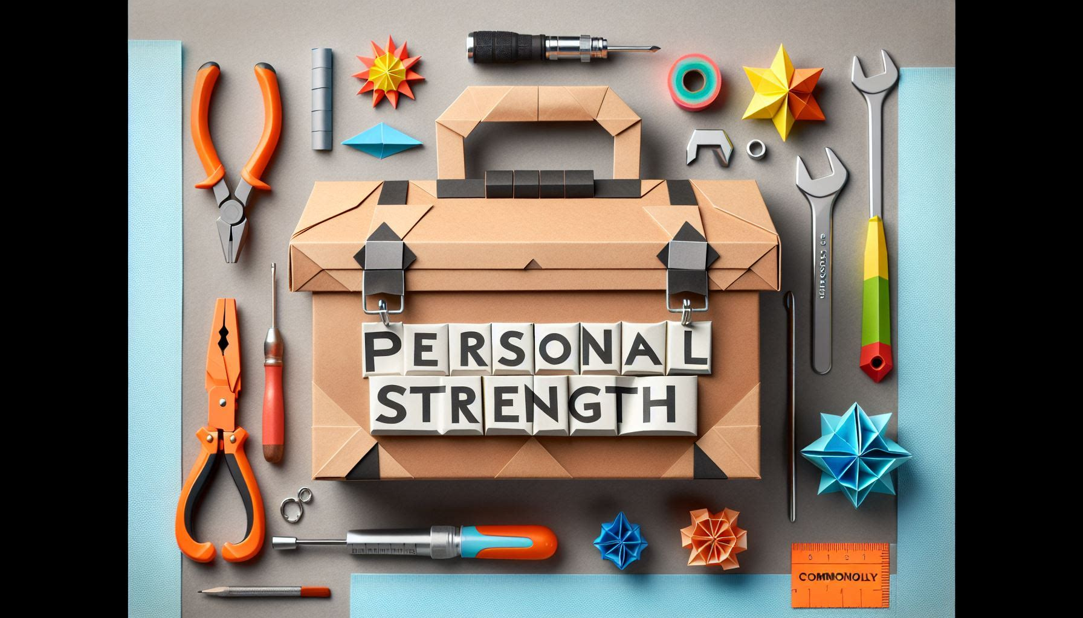
What Are Personal Strengths?
Personal strengths are things you are good at or qualities you have that are positive.
They can be skills like drawing or solving puzzles.
Or they can be about your character, like being kind or a good listener.
Everyone has different strengths!
Why do you think it's good to know your strengths?
Can anyone tell me what you think a "personal strength" is?
Notes:
Please give time for the students to produce answers for themselves before showing answers.

Slide 12
Discovering Your Strengths
You can find your strengths by thinking about what you enjoy and do well.
Sometimes, friends or family can tell you strengths you might not see.
Trying new things can also help you discover more strengths.
Remember, everyone is unique, so your strengths are special to you!
How can trying new things help us find our strengths?
What's something you love to do and feel-good doing?
Notes:
Please give time for the students to produce answers for themselves before showing answers.

Slide 13
Why Strengths Matter
Knowing your strengths helps you feel good about yourself.
It can help you pick activities or tasks where you can do your best.
Using your strengths can make learning and working with others more fun.
Sharing your strengths can help your friends or team too.
How can using your strengths make a group project more fun?
Why do you think our strengths are important?
Notes:
Please give time for the students to produce answers for themselves before showing answers.

Slide 14
Growing Your Strengths
Practice regularly, even if you're already good at it.
Learn from others who have the same strength.
Teach someone else your strength to understand it better.
Keep trying, even when it gets hard. That's how you grow!
How do you think you can get better at something you're already good at?
Can you think of one strength you’d like to improve? How will you do it?
Notes:
Please give time for the students to produce answers for themselves before showing answers.

Slide 15
Strengths Speed Dating
You have 1 minute to share something you are good at with a partner.
Make sure you both get to talk.
You tutor will tell you when a minute is up.
Repeat the conversions with a new partner.
Do as many conversions as you can in the time you have.

Slide 16
Self-Worth
Identifying personal strengths
Setting goals

Slide 17
Secure Your Relationships:
Building relationships
Setting goals

Slide 18
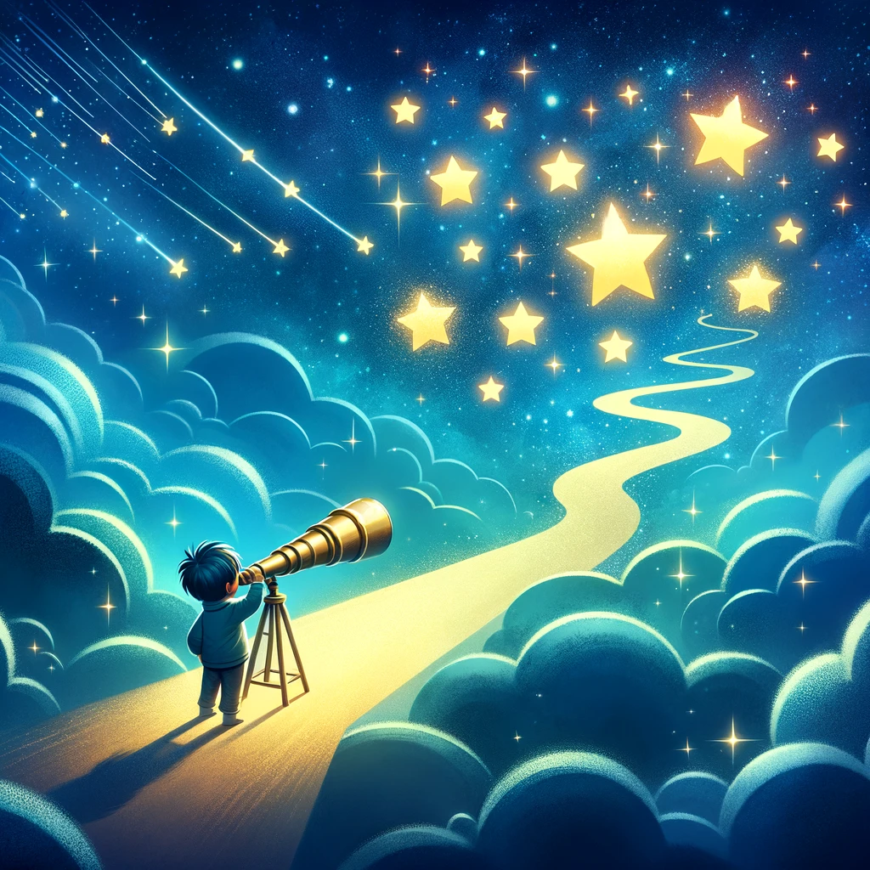
What Are Goals?
A goal is something you want to achieve or get better at.
It's like aiming for a star in the sky.
Goals can be big or small, like learning to ride a bike or finishing a book.
Having goals helps us grow and learn new things.
Can you think of a small goal you might have?
What do you think a goal is?
Notes:
Please give time for the students to produce answers for themselves before showing answers.

Slide 19
How to Set a Goal
Think of something you really want to do or improve at.
Make sure it's something possible for you right now.
It helps to write it down and think about the steps to get there.
Share your goal with a friend or family member for support.
How do you decide what your goal should be?
Why is it helpful to share your goal with someone?
Notes:
Please give time for the students to produce answers for themselves before showing answers.

Slide 20
Working Toward Your Goals
Break your goal into smaller steps that you can do one at a time.
Celebrate each step you complete—it's part of reaching your goal!
If something is hard, it's okay to ask for help.
Keep trying, even if it takes time to reach your goal.
What can you do to start working on your goal?
Why is it important to celebrate the small steps?
Notes:
Please give time for the students to produce answers for themselves before showing answers.

Slide 21
Keeping Your Goals
Keep your goal where you can see it, like on a note in your room.
Check how you're doing once in a while and adjust your plan if you need to.
Talk about your progress with someone who supports you.
Remember, it's okay if your goal changes as you learn and grow.
How can changing your goal be a good thing?
What can you do to remember your goal and keep going?
Notes:
Please give time for the students to produce answers for themselves before showing answers.

Slide 22
Goal Setting Time Capsule
Write down one or more goals on your piece of paper.
The goals should be what you want to achieve before the end of Year 7 (Roll-up)
Fold the paper in half, write your name on it, and give it to your tutor.
In the last week, you will see if you have achieved the goals or at least started towards achieving them.
Notes:
Please give the students an A5 piece of paper to write on for this activity.

