Slide 1
Secure Your Relationships
Different types of families and changing structures

Slide 2
Family structures
Changing structures
Information on structures

Slide 3
Secure Your Relationships:
Families
Family structures

Slide 4

Introduction to Family Structures
Family Structures: Different ways families are formed.
Examples: Nuclear, single-parent, extended.
Nuclear Family: Parents and children living together.
Single-Parent Family: One parent and children.
Can someone give an example of a nuclear family?
What types of families do you know?
Notes:
Please give time for the students to produce answers for themselves before showing answers.

Slide 5
Extended and Blended Families
Extended Family: Includes relatives like grandparents, aunts, uncles.
Blended Family: Families blending from previous relationships.
Living Together: Sharing homes and lives.
Support System: Providing care and support.
Why might some people choose to live in extended or blended families?
Have you heard of extended or blended families? What are they?
Notes:
Please give time for the students to produce answers for themselves before showing answers.

Slide 6
Foster Families
Foster Families: Temporary homes for children in need.
Care and Support: Providing a safe and loving environment.
Many Reasons: Why children might live with foster families.
Important Role: Helping children grow and feel secure.
How do foster families help children?
What does it mean to foster a child?
Notes:
Please give time for the students to produce answers for themselves before showing answers.

Slide 7
Diversity in Families
Diversity: Families come in all shapes and sizes.
Understanding: Helps us appreciate everyone's unique situation.
Respect: Recognising and valuing different family forms.
Community: Supporting each other as a school and community.
How can we show respect to all types of families?
Why is it important to understand different family structures?
Notes:
Please give time for the students to produce answers for themselves before showing answers.

Slide 8
Discussion
How do you think life might be different for someone in a different family structure than your own?
Why do you think certain family structures are more commonly represented in media than others?
How have family structures evolved over time, and what factors contribute to these changes?

Slide 9
Family structures
Changing structures
Information on structures

Slide 10
Secure Your Relationships:
Building relationships
Changing structures

Slide 11
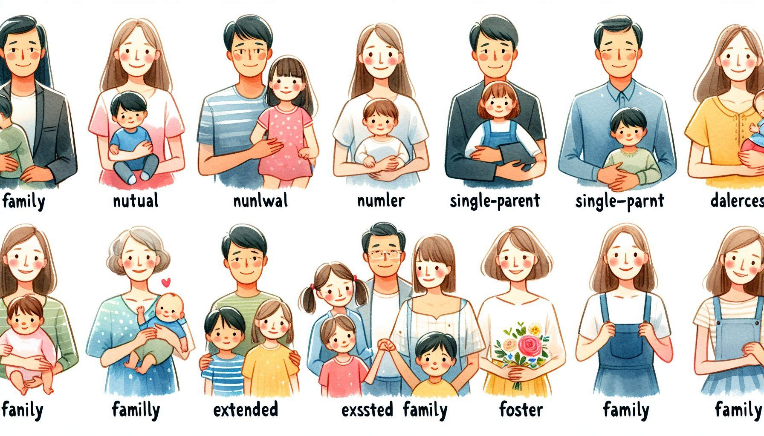
The Traditional Family Structure
Traditional Family: Often means a nuclear family.
Nuclear Family: Parents and children living together.
Common in the Past: This was the most recognised form.
Changing Views: Society's understanding of 'family' evolves.
What comes to mind when you hear 'traditional family'?
Why do you think the nuclear family was considered the norm?
Notes:
Please give time for the students to produce answers for themselves before showing answers.

Slide 12
Rise of Single-Parent Families
Single-Parent Family: One parent raising children.
Increasing Numbers: More common in recent decades.
Various Reasons: Due to choice, circumstances, or loss.
Strength and Challenges: Highlighting resilience and support needs.
Can someone describe a single-parent family?
What strengths do you think single-parent families demonstrate?
Notes:
Please give time for the students to produce answers for themselves before showing answers.

Slide 13
Extended and Blended Families
Extended Family: Includes wider relatives living together or closely.
Blended Family: A mix of step-siblings and half-siblings from previous relationships.
Support System: Both provide strong family support.
Cultural Importance: More prevalent in some cultures.
How can extended and blended families benefit individuals?
What’s the difference between extended and blended families?
Notes:
Please give time for the students to produce answers for themselves before showing answers.

Slide 14
Foster Families and Adoption
Foster Families: Provide temporary care for children.
Adoption: Creates a permanent family for a child.
Needed for Various Reasons: Including safety, care, and love.
Important Role: Offering stability and support.
Why might children live in foster families or be adopted?
What do you think are the challenges and rewards of fostering or adopting a child?
Notes:
Please give time for the students to produce answers for themselves before showing answers.

Slide 15
Reflecting on changing families
How can understanding the history and evolution of family structures help us better appreciate the diversity and complexity of families today?

Slide 16
Family structures
Changing structures
Information on structures

Slide 17
Secure Your Relationships:
Building relationships
Information on structures

Slide 18
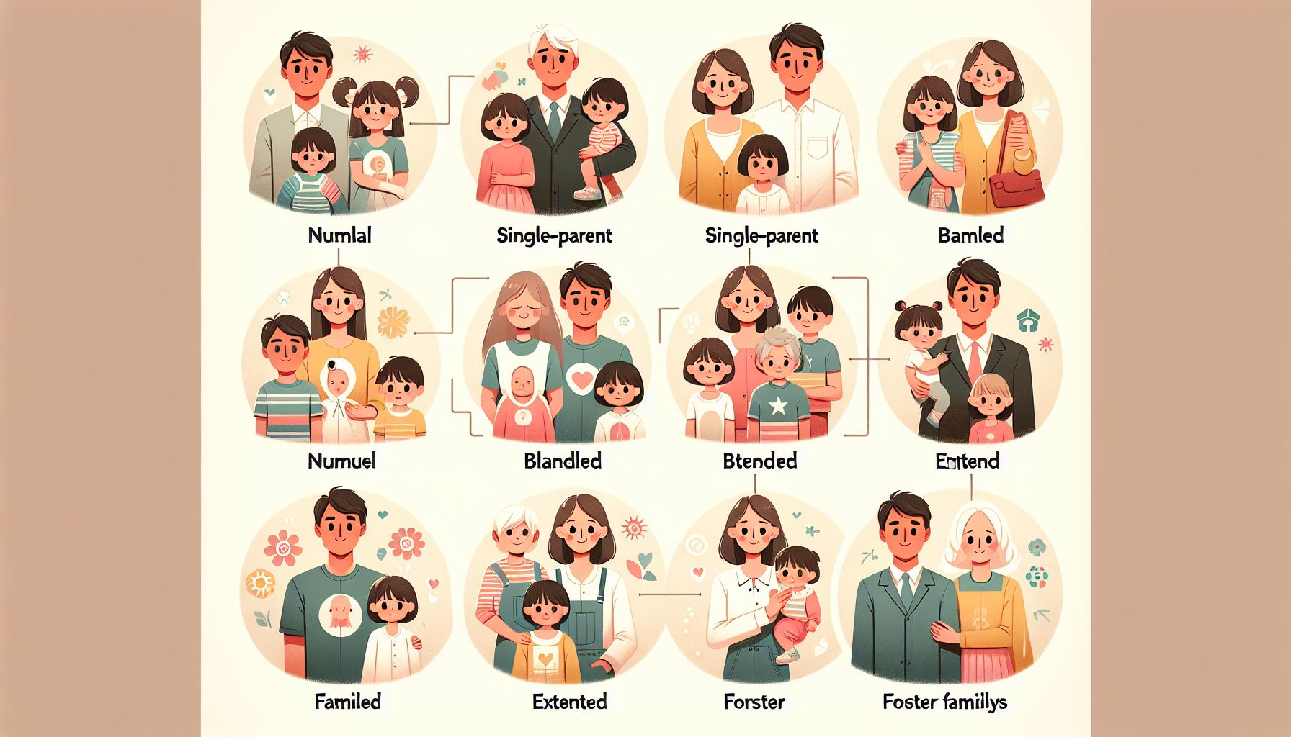
Emotional Support in Families
Emotional Support: Love, trust, and understanding shared in a family.
Forms: Listening, encouraging, and comforting.
Necessary for All: Helps us feel secure and valued.
In Every Family: Present in nuclear, single-parent, and others.
Can anyone explain what emotional support means in a family?
Why is emotional support important in families?
Notes:
Please give time for the students to produce answers for themselves before showing answers.

Slide 19
Financial Support in Families
Financial Support: Providing for the family's monetary needs.
Examples: Paying for food, shelter, education.
Varies by Family: Different structures manage differently.
Team Effort: Everyone can contribute in various ways.
What might financial support look like in a family?
How do different family structures manage financial support?
Notes:
Please give time for the students to produce answers for themselves before showing answers.

Slide 20

Practical Support in Families
Practical Support: Helping with day-to-day tasks.
Examples: Cooking, cleaning, transportation.
Teaches Responsibility: Everyone has a role to play.
Strengthens Bonds: Working together brings families closer.
Can you give examples of practical support within a family?
Why is practical support important for family bonding?
Notes:
Please give time for the students to produce answers for themselves before showing answers.

Slide 21
Support Systems Across Family Structures
Different, Yet Similar: All families offer support, but the way they do can vary.
Adaptability: Families adapt to provide the needed support.
External Support: Friends, community, and social services can also play a role.
Understanding and Respect: Recognising each family's unique support system is key.
How can support systems vary across different family structures?
How does understanding different support systems in families help us appreciate them more?
Notes:
Please give time for the students to produce answers for themselves before showing answers.

Slide 22
Supporting families in the community.
How can we, as individuals and a community, contribute to the support system of various family structures around us?
Notes:
Discuss the answers when student disagree with the answers

